Slide 1
CAN THO UNIVERSITY
SCHOOL OF INFORMATION & COMMUNICATION TECHNOLOGY
INFORMATION TECHNOLOGY HIGH-QUALITY PROGRAM
GRADUATION THESIS
DEVELOPING A MUSHROOM IDENTIFICATION
APPLICATION
Advisor: Dr. Bùi Võ Quốc Bảo
Student: Nguyễn Quang Vinh (B2105727)

Slide 2
Content
Part 1: Introduction
Part 2: Theoretical basis & systems analysis
Part 3: Implementation
Part 4: Conclusion

Slide 3
Part 1: Introduction

Slide 4
1.1. Problem Description
Mushroom identification is difficult for beginners due to subtle similarities.
Traditional methods require prior knowledge and are prone to errors.
Misidentification can cause serious health risks.
Growing interest in foraging has increased demand for reliable, accessible tools
Existing digital solutions are often limited by high cost or restrictive freemium models.

Slide 5
1.2. Purpose of the Study
Develop a beginner friendly Android app for safe mushroom identification that support safe foraging practices and self-learning.
Provide real time image recognition using a server-side model with local result storage.
Include a keyword-searchable mushroom database.
Integrate an interactive forage map using iNaturalist community observations.

Slide 6
1.3. Objectives & Scope
Objectives:
Build an app that delivers reliable AI-based identification.
Design a fast client server architecture with intuitive UI/UX.
Combine image inference, search, history, and map features.
Scope:
Android app using Flutter, server inference via PyTorch + Lightning.ai.
Local SQLite storage and a bundled JSON dataset.
Integration of iNaturalist API.

Slide 7
Part 2: Theoretical basis & systems analysis

Slide 8
2.1. Key Technologies
Flutter/Dart: Cross-platform UI framework for fast Android development.
SQLite + JSON: Local data storage and offline mushroom information.
OpenStreetMap + iNaturalist API: Interactive map and community observations.
PyTorch + Transformers: Training, deploying, and serving the ViT model.
FastAPI + LitServe (Lightning.ai): High-performance API layer for inference.

Slide 9
2.2. Vision Transformer Model
Google/vit-base-patch16-224-in21k (Pre-trained on ImageNet-21k)
  Higher accuracy than ResNet-50, EfficientNet, and MobileNet on our mushroom dataset
  Perfect for subtle details and complex textures

Slide 10
2.3. Dataset & Augmentation
Dataset: 80 classes × 200 images each (16,000 total).
Sources: iNaturalist, Kaggle, WildFoodUK, blogs.
Splits: 80% training, 10% validation, 10% test.
Augmentation: flips, rotate, brightness/contrast, hue/saturation, blur, noise, dropout.

Slide 11
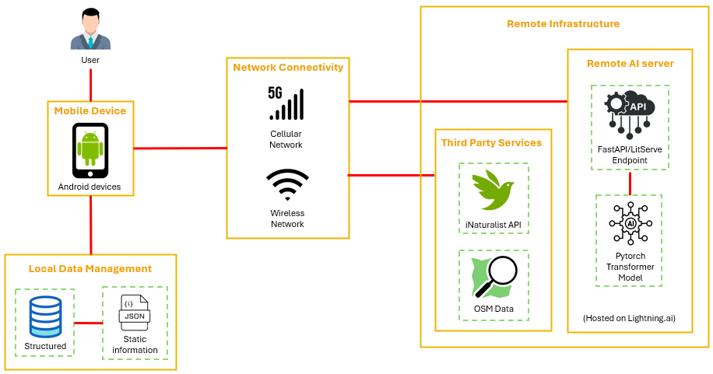
2.4. System Architecture Overview

Slide 12
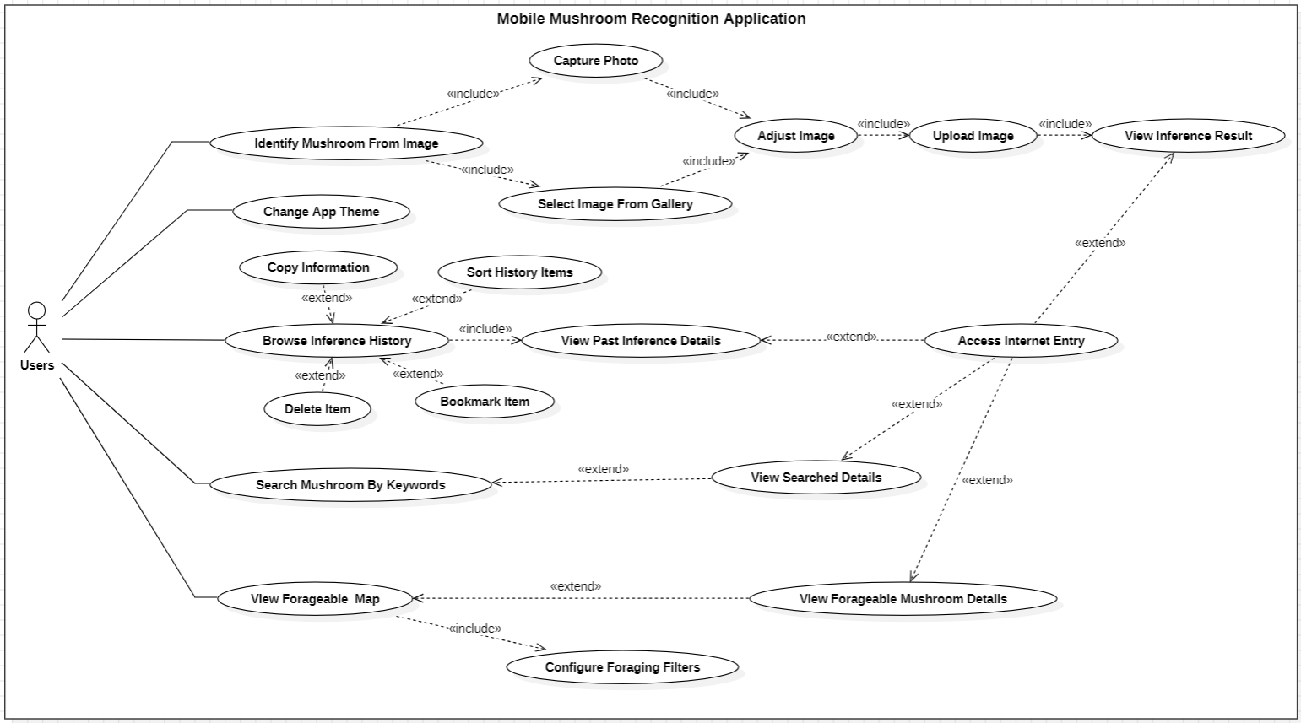
2.5. Use Case Overview

Slide 13
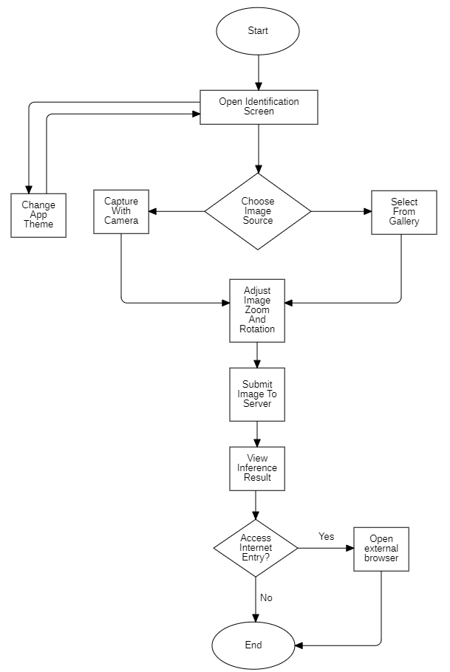
2.6. Main System Workflows

Slide 14
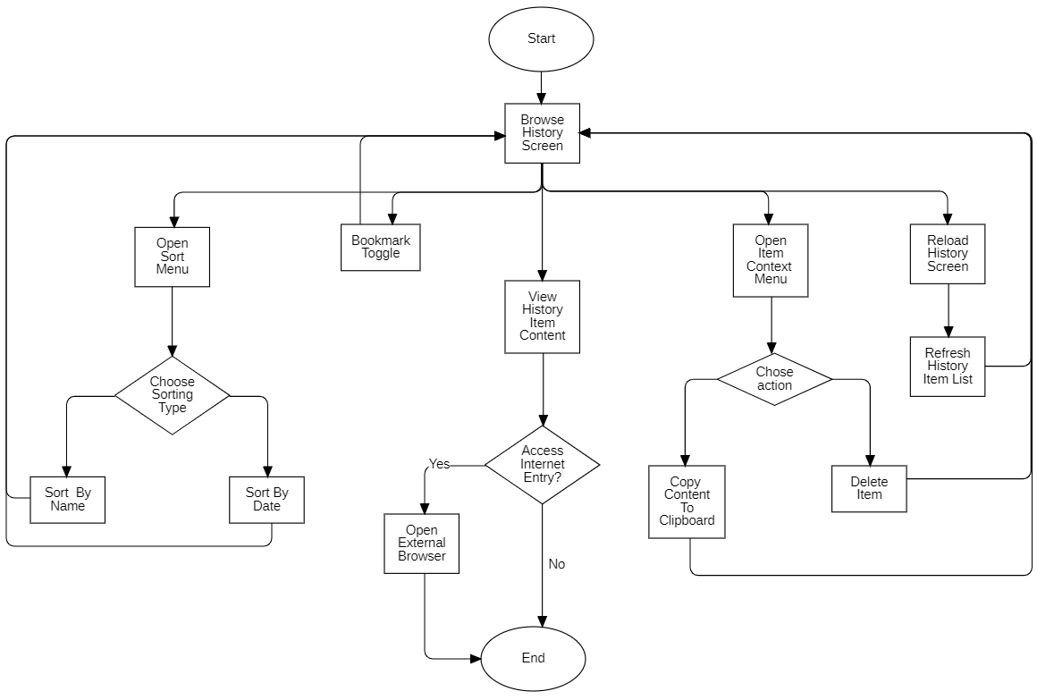
2.6. Main System Workflows

Slide 15
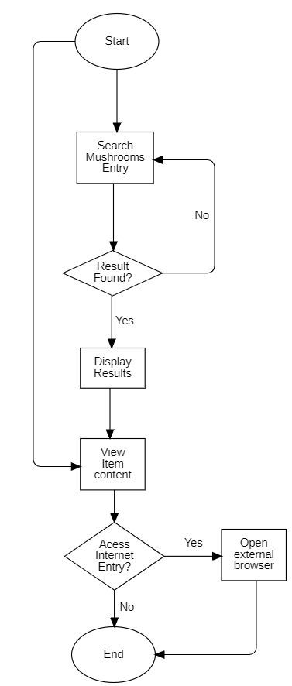
2.6. Main System Workflows

Slide 16
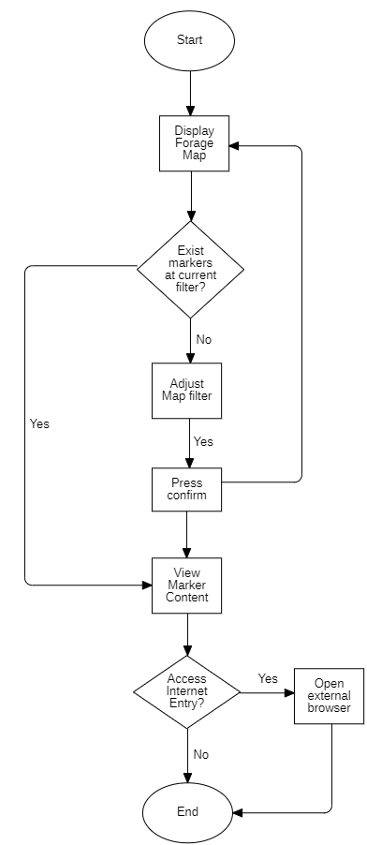
2.6. Main System Workflows

Slide 17
Part 3: Implementation

Slide 18
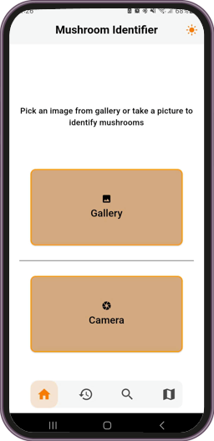
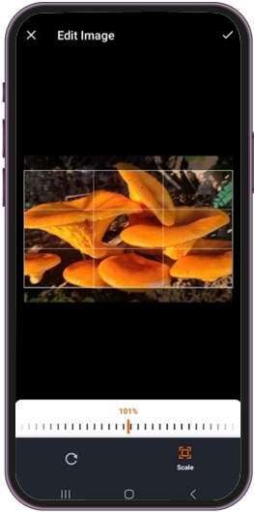
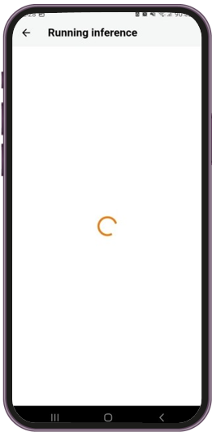
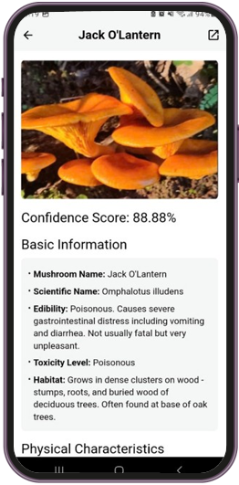
3.1. UI Implementation

Slide 19
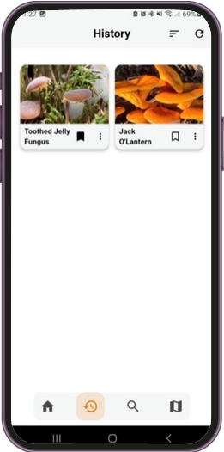
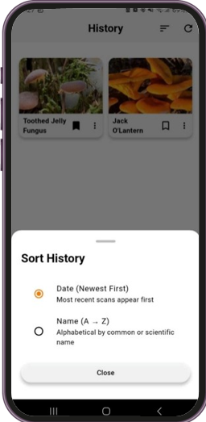
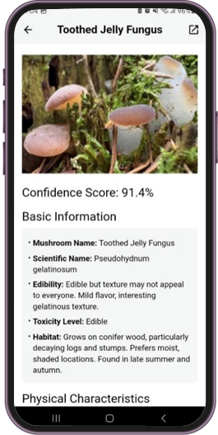
3.1. UI Implementation

Slide 20
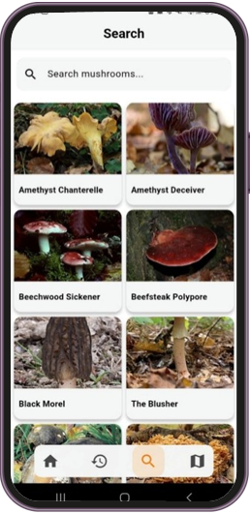
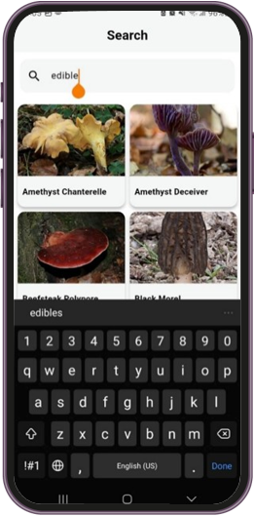
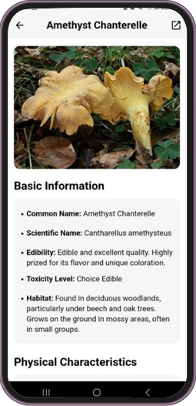
3.1. UI Implementation

Slide 21
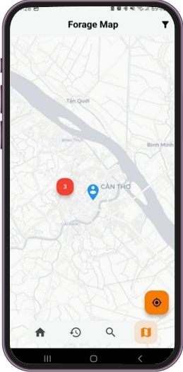
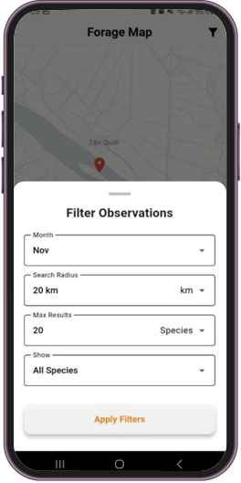
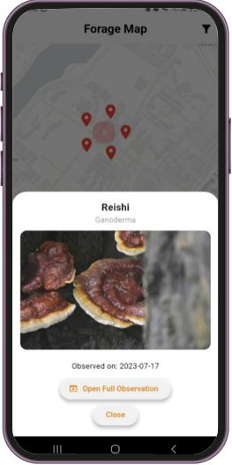
3.1. UI Implementation

Slide 22
3.2. AI Model Implementation
FUCK I FORGOT TO ADD THE METRIC I FORGOT TO ADD THE METRIC TO MEASURE THIS FUCKING GARBAGE

Slide 23
3.2. AI Model Implementation
Model | Macro-Averaged Precision | Macro-Averaged Recall | Macro-Averaged F1 Score | Macro-Averaged AUC
ViT | 0.89 | 0.88 | 0.88 | 0.998
ResNet-50 | 0.85 | 0.84 | 0.84 | 0.997
EfficientNetB4 | 0.84 | 0.83 | 0.83 | 0.996
MobileNetV3 | 0.83 | 0.82 | 0.82 | 0.995

Slide 24
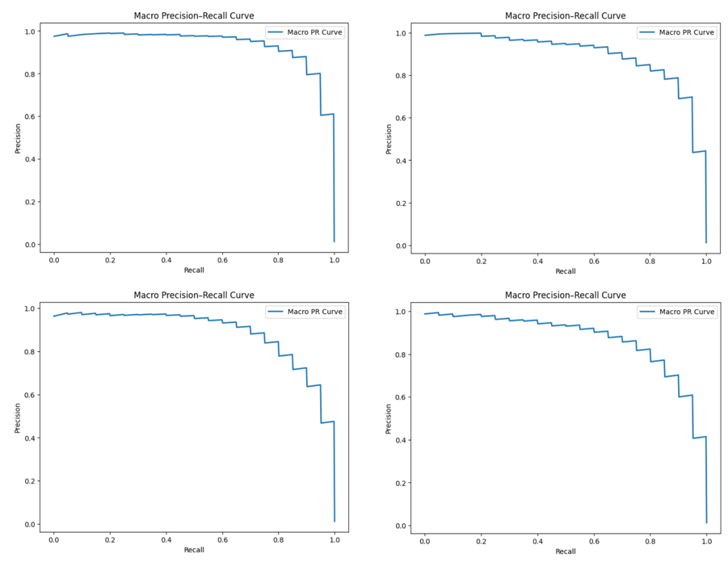
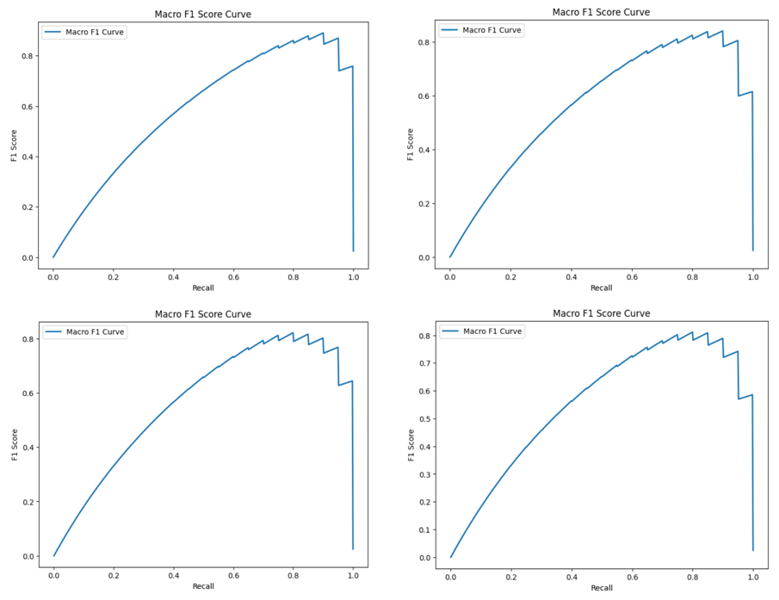
3.2. AI Model Implementation

Slide 25
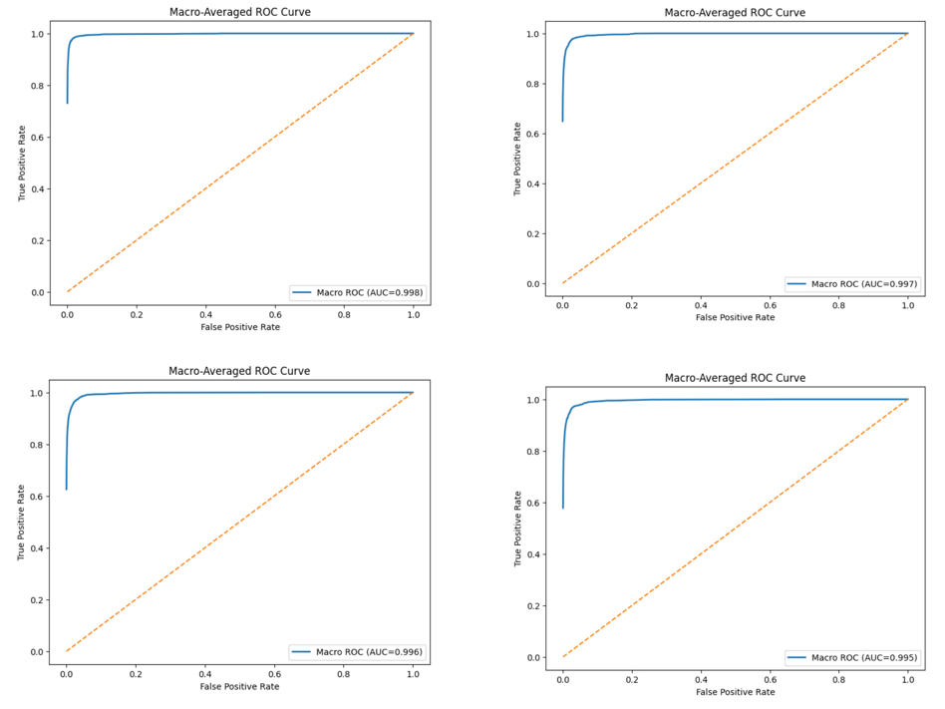
3.2. AI Model Implementation

Slide 26
Part 4: Conclusion

Slide 27
4.1. Achieved Results & Limitations
ACHIVED RESULTS:
Developed a beginner-friendly Android app for mushroom identification
Real-Time image recognition using a server-side ViT model with local storage
Keyword search powered by a bundled JSON dataset
Interactable map integrated with iNaturalist API.
CURRENT LIMITATIONS:
Limited and undiversified training data, overfitting not fully mitigated.
The current ViT model has yet achieved desired accuracy on all classes
Some features remain incomplete or underdeveloped
Notes:
Achived results:
2. local **result** storage
Current limitations:
3. which are the search feature and forage map.

Slide 28
4.2. Development Direction
DEVELOPMENT DIRECTION:
Expand recognition to more wild edibles using multi-task or speciated models.
Use larger ViT variants for higher reliability.
Increase and improve the dataset and augmentation to reduce overfitting.
Upgrade keyword search to a natural-language chatbot with a small LLM.
Add iNaturalist user-contributed observations to enrich the forage map.
Notes:
Either through a multi-task model or a separate specialized classifier

Slide 29
THANK YOU VERY MUCH
Can Tho University

